Slide 1
History of Photoshop
Photoshop was created in 1988 by Thomas and John Knoll. Since then, it has become the de facto industry standard in raster graphics editing, such that the word "photoshop”.

Slide 2
Photoshop Version History
CS The first Photoshop CS was commercially released in October 2003 as the eighth major version of Photoshop.
Photoshop CS2, released in May 2005,
CS3 released in April 2007
CS4 released on 15 October 2008.
Photoshop CS5 was launched on 12 April 2010.
Photoshop CS6, released in May 2012.
Photoshop CC was launched on 18 June 2013.
Photoshop CC 2014 was released on 18 June 2014
Photoshop CC 2015 was released on 15 June 2015

Slide 3
What is Photoshop?
Photo retouching, image editing, and color
painting program; graphic design tool
Create high-quality digital images
Tools & special effects capabilities
Manipulate scanned images, slides, & original artwork
Isolate parts of an image for experimentation & individual editing
And lots more…..

Slide 4
Uses of Photoshop
Art (line drawings, charcoal, color original)
Photographic
Restoration
WWW (GIFS, JPEGS, etc.)
Montage
Halftones, Duotones, Tritones, Quadtones
Color Separations
Posterizations
Special Effects

Slide 5
File Formats
JPEG – Joint Photographic Experts Group
GIF – Graphics Interchange Format
PNG – Portable Network Graphics
Notes:
JPEG
Pronounced Jay-Peg
JPEG actually compression algorithm, not a file format
JPEG associated with JFIF (JPEG File
Interchange Format)
GIF
Pronounced Jiff, although most call it Giff
PNG
Pronounced Ping
Newer file format
Will see more in future

Slide 6
JPEG
Best for photos or continuous tone, full-color images
Uses 16 million colors
Browsers use reasonable approximations
Work in RGB mode
Uses lossy compression
Saving (Standard, Optimized, Progressive)
Notes:
Lossy Compression
Smaller Files
Discards Info
Removes Details & Color
Eye can’t see
Will lose quality when adjusting/reducing file size
Interlacing Effect with Progressive
Display low resolution image first
Followed by higher resolution
Fills in details
Ends with highest quality

Slide 7
GIF
Best for solid color images (buttons, logos)
Uses 256 colors
Browsers uses 216 colors
Work in Indexed mode
Good compression
Interlaced
Notes:
Uses Lossless Compression
Never discards any info about original file
Interlacing
Display low resolution image
Followed by higher resolution
Ending with highest quality

Slide 8
PNG (8-bit)
Best for line art (logos)
Compresses solid areas of color well and maintains sharp detail
Generally, has better compression than GIF (10-30% smaller)
If considering saving as GIF, also consider saving as PNG (8-bit)
Not supported by older browsers

Slide 9
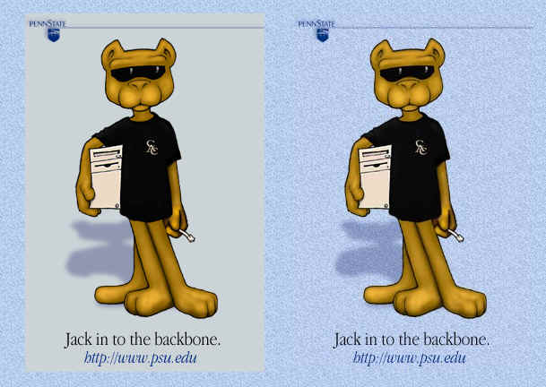
JPEG vs PNG
Comparison of JPEG and PNG
68K PNG
31K JPG

Slide 10
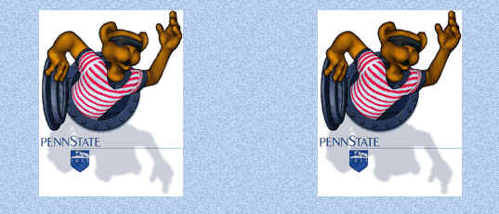
GIF vs PNG
Comparison of JPEG and PNG
10.8K PNG-8 with 64 colors
9.5K GIF with 64 colors

Slide 11
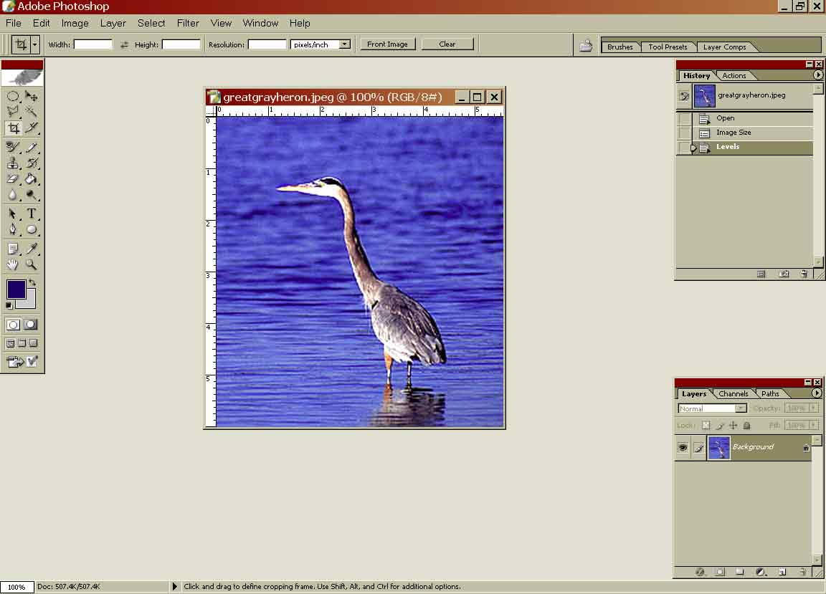
The Photoshop workspace
Options palette
History palette
Layers palette
toolbox
image
Notes:
Switch from pp to screen – everyone open it up

